Slide 1


Mobile Last Development
An anti-project:
economics, physics and webdesign

Slide 2
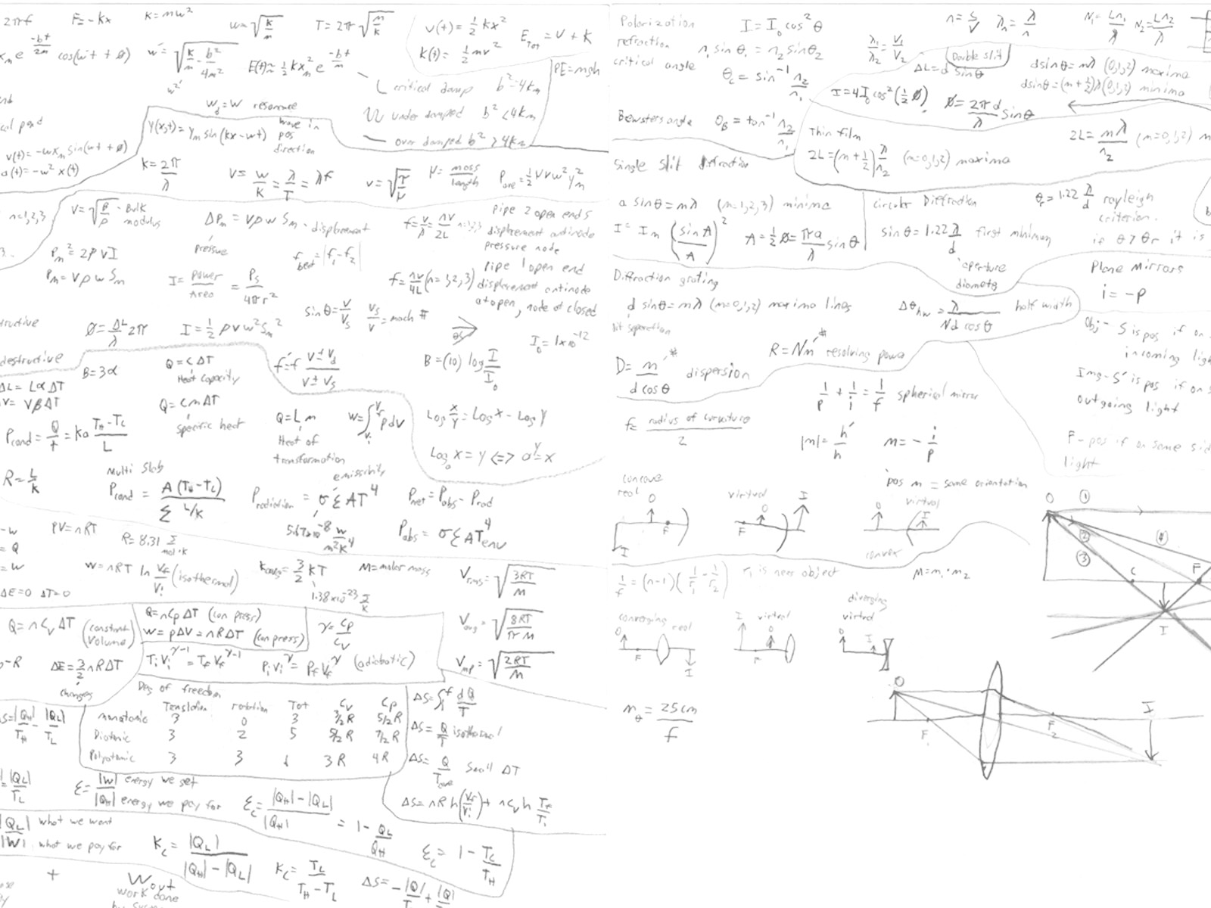
Best practices, worst practices
Synopsis
Principles of mobile first development
Lessons in physics
Real life solutions
Notes:
By illustrating the differences, we can better argue WHY we design mobile first.
The examples are real, the project ist real. It‘s very challenging, but it‘s also sad, in a way.
Before anyone says „of course we always design mobile first, because, because...why?“ ...and why we didn‘t

Slide 3


The project history: a synopsis

Slide 4

The birth of an anti-project
The scope of the initial project was limited by budget considerations.
In spite of all advice to the contrary, the client insisted on producing only desktop and tablet views.
The objections of the programmers were mitigated by the perceived flexibility of the planned responsive grid system.
Notes:
Saving time and money by limiting the scope of the project is a well-accepted method. Critical examination of the parts to be limited is essential. Is is a quick win or an illusion?
The sub-tablet views were regarded as non-essential, as a simple „extension“ of the tablet and desktop views
The sub-tablet views were regarded as simple in nature and therefore requiring less effort
The grid system (bootstrap) provides an array of pre-set breakpoints for mobile views. It was hoped that simply activating the breakpoints would do much of the work.

Slide 5
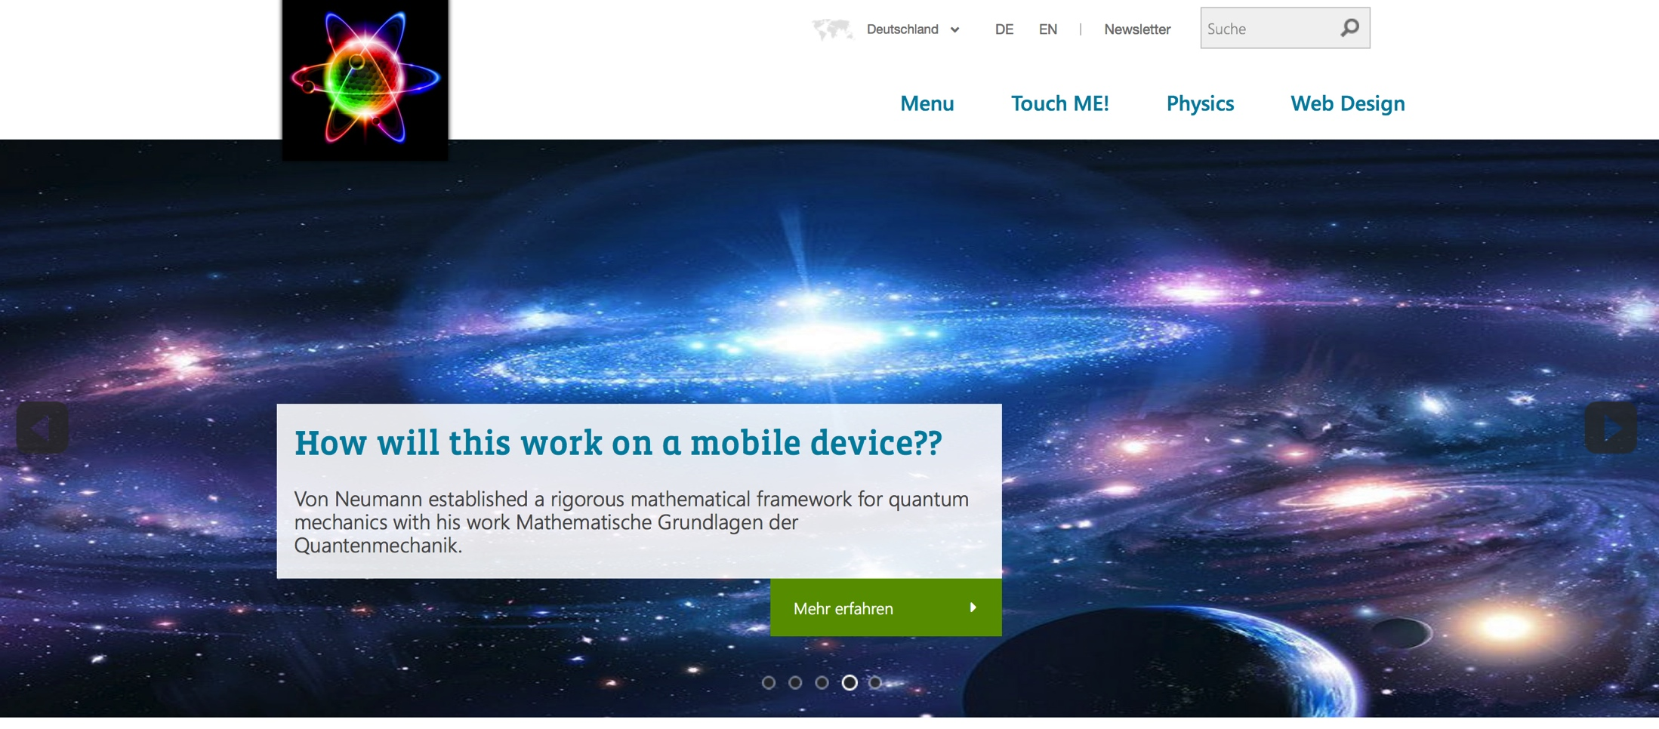
Desktop and Tablet Views: the stage
Notes:
Developers, particularly if plagued by time and budget, Will take the path of least resistance.
The grid my be responsive and offer tools to aid the developer, but Responsive versions of special content objects are simply rationalized out of scope!

Slide 6
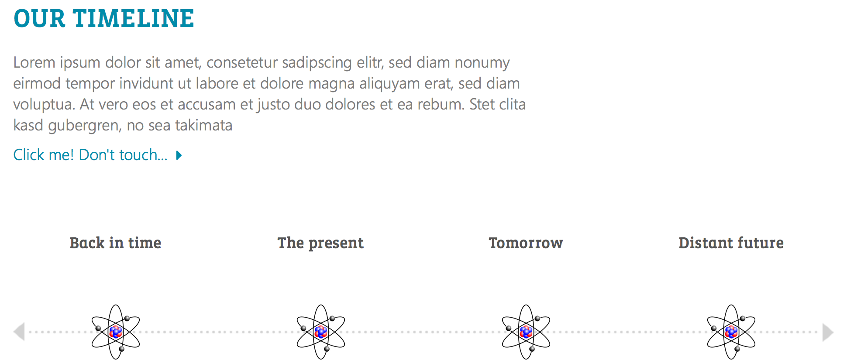
Desktop and Tablet Views: the timeline
Notes:
Design elements and screen modules are implemented around the horizontal axis
Images are conceived with for the performance and dimensions of larger screens
The UX includes text links and hover effects

Slide 7
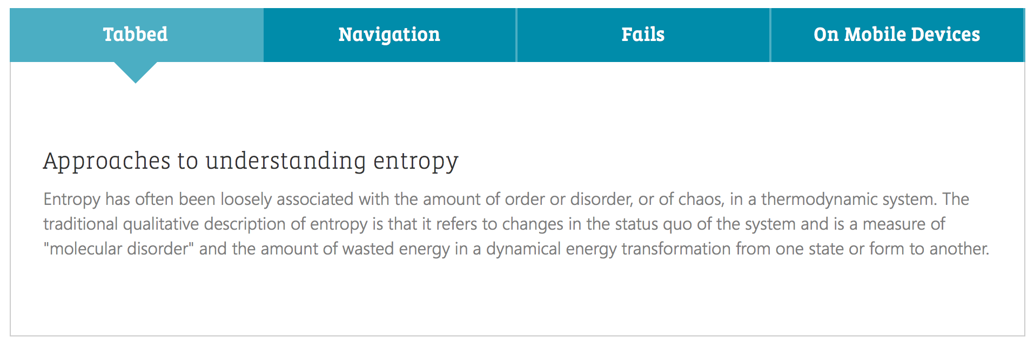
Horizontally aligned content elements (tabs)
Notes:
Developers, particularly if plagued by time and budget, Will take the path of least resistance.
Responsive versions of special content objects are simply rationalized out of scope!

Slide 8
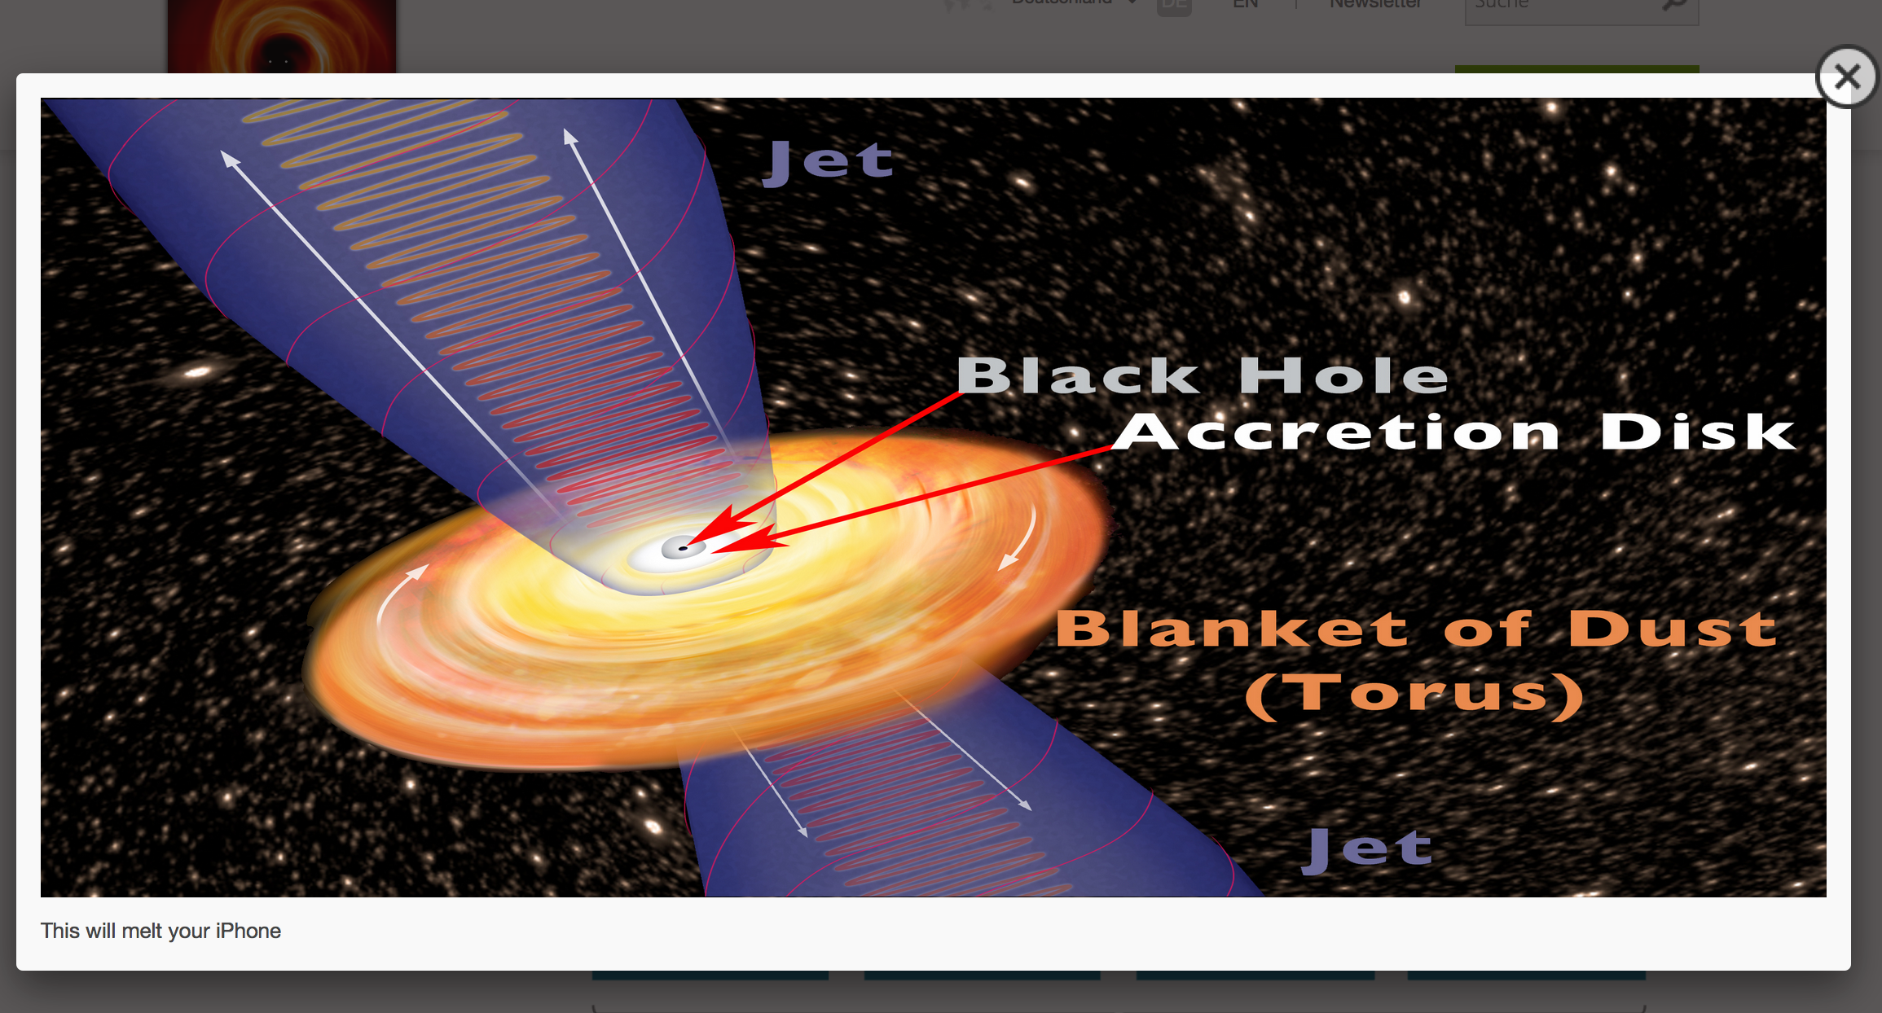
Rich(er) media often fail.
Notes:
Lightboxes, sliders, animations, stages. Loved by clients, programmers and designers alike. But these elements are all orientated horizontally and often don‘t perform well on mobile devices.
Lightboxes usually don‘t scroll. Vertical content ALWAYS does.

Slide 9


Develop Mobile First! Best Practices

Slide 10
Concentrate on the essentials!
Mobile users want quick, easy access to information.
One thumb, one eyeball.
Touch me, please.
Low-density navigation and quick-loading designs save lives.
Notes:
Not with ten fingers, two eyes and headphones.
Not for emergency situations,
But rather going down a staircase
Crossing busy streets
Walking through construction sites

Slide 11
Work from the bottom up!
Start with the smallest screen.
Animations and rich media are to be regarded critically.
Let the grid do the work.
Leave the DOM alone!
Notes:
Avoid using JavaScript to manipulate the HTML-Nodes (DOM)
If your grid is fluid, it will help you by scaling content and reducing the need for breakpoints
We‘re headed even smaller than 280 / 320

Slide 12
Work from the bottom up!
The initial media query is the anti-query.
Make media-queries start with the minimum range for the view scope.
Breakpoints should be programmed around content, not screens.
The image concept starts at street level.
Notes:
As the screens grow larger, allow new features
The first, unaldultered CSS Rules are for the smallest screens!
Maybe your teasers will break well at sub tablet resolutions, but your image gallery won‘t
If images are providing relevant, visual information rather than decoration, you need a media concept for mobile!

Slide 13
Progressive Enhancement versus… graceful degradation
Programm rules which work, rather than exceptions which are designed to break.
The fallback should remain just that.
Which percentage of your target audience will enjoy the „full experience“?
Notes:
Fewer and fewer users are sitting at their desks while calling up content on the web
Fallbacks should be in place only for non-standard use cases ( classically, when JavaScript is deactivated )

Slide 14
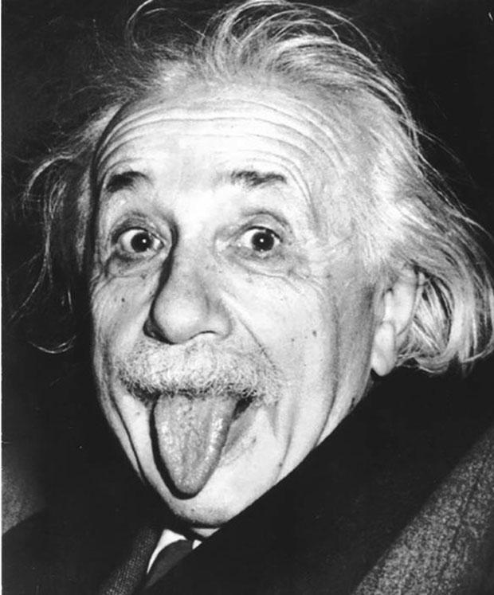

Software Development clever-sounding formulae

Slide 15

The jump from tablet to mobile view is often the most complex.
C = design complexity
S_{D} = Desktop size
S_{T} = Tablet size
S_{M} = Mobile size
C₁ = ( S_{D} - S_{T} )
C₂ = ( S_{T} - S_{M} )
(C_{1 ,} C_{2, ...}C_{n}) = $$$$$
Notes:
The shift from desktop to tablet views is minimally invasive, often requiring only scaling within the fluid grid
Desktop and Tablet are landscape formats by nature
The shift from tablet to mobile involves an entirely new mindset, design, media, content,
„Simply activating the breakpoints“ did little
-> images were not responsive
-> horizontal elements became useless or were broken
-> the navigation no longer functioned
-> The most pragmatic solution was often „hidden-xs“

Slide 16
Project entropy as a transition from order to chaos.
L = Project Lifetime since go-live
C = amount of Chaos resulting from deltas to the system
F = Original Featureset
O = Order as a numerical representation of stability
C = f ( (L * F) / O)
Notes:
Content has been entered and new features added over the life of the project since.
The most ordered web project will descend into chaos over a matter of time. It‘s life cycle depends in part on the scalabilitly, flexibility and stability of the system
Different developers have differing styles and methods
New technologies are implemented, but the old technologies they replace leave artefacts in the system
Workflows, content types have solidified, images are immutable, naming conventions are in place
The mobile view is a new feature, not an

Slide 17


Real solutions, …not ideal solutions

Slide 18
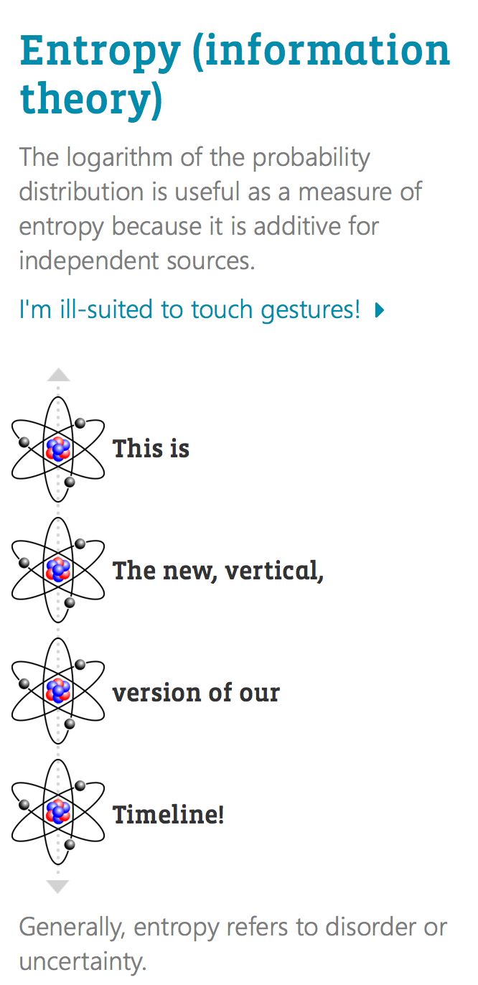
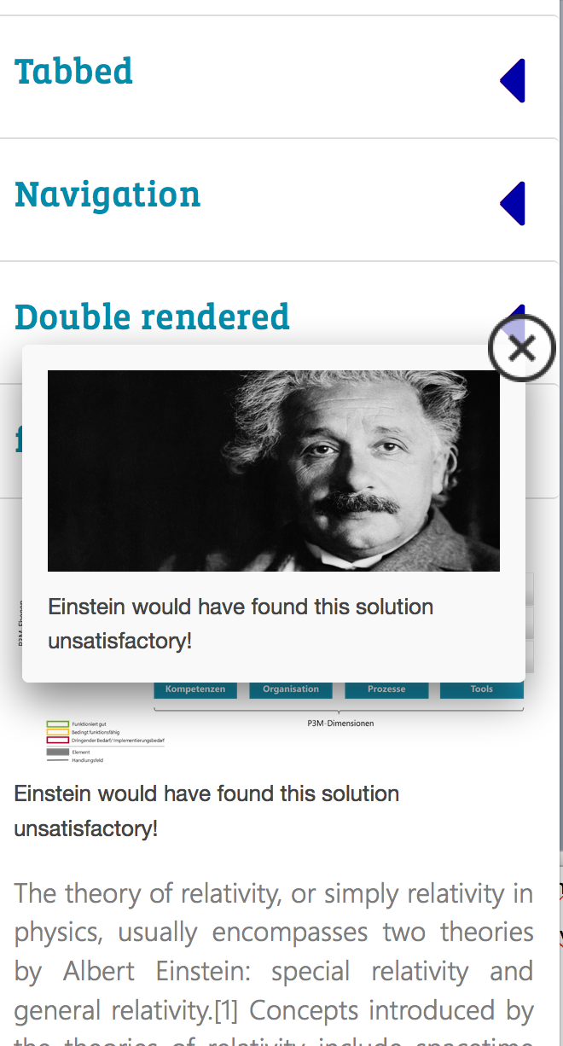
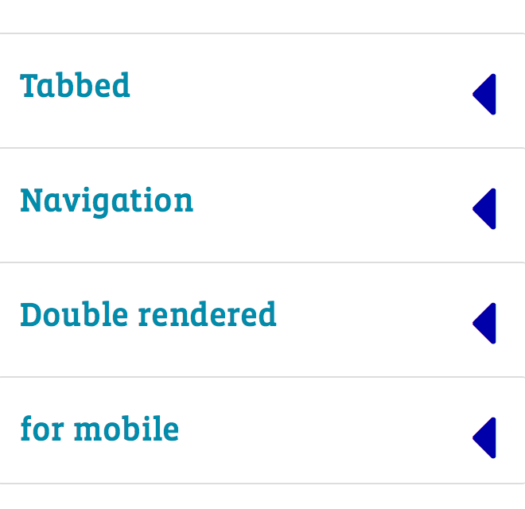
Binary or tertiary solutions are often necessary
Notes:
The lightboxes have little relevance and sould probably be deactivated entirely
...but the plugin and graphics leave a 100k footprint, solution: dynamically load the JS.
The tabs and timeline are now binary solutions (DOM manipulation and binary templating)
The stage will become tertiary solution, requiring three sets of javascript initilisation parameters and CSS rulesets

Slide 19
Thanks!
Dan Fitzpatrick

